Slide 1

Test automation in ABAP
Krisztián dr. Mihály, SAP
Tamás Szántai, SAP

Slide 2
Agenda
Purpose of test automation
Test types
Testable objects
The ABAP Unit framework
  Testdouble frameworks
Writting testable code
Best practices, useful patterns

Slide 3
The purpose of test automation

Slide 4
Why do we use test automates?
They save time and effort
  If your test cases are implemented as test automates, there is no need to perform them manually.
  Simple, repetitive test cases can be tedious and boring task and consume valueable time and mental capacity.
  Complex test cases might require lot of effort, special knowledge or authorizations to be prepared
They are repeatable
  No matter „who” performs the tests, the test automates do always the same thing.
  It is not dependent on the tester, what cases will be tested and which not.
  Functional coverage of the tested functionality is predictable.
They can be atomic or complex
  Test automation enables you to scale your test cases depending on the complexity
    Unit test coverage can be very high (low cost)
    End-to-end scenario test can focus on the most important cases (high cost/high risk ones)
They ensure code quality
  If the expected behavior of your functionality is properly covered by test automates, you can be sure, that there will be no regression issues caused by future changes or enhancements.
  Test automates can be executed immediately after changes are done, so any errors caused can be immediately revelead by the developer.
They document the functionality
  A properly formulate set of test automates describes the intended behavior of the tested object.
  There are some techniques that even allow non-developers to understand the purpose of the tests and the features covered by them.

Slide 5
Test types

Slide 6
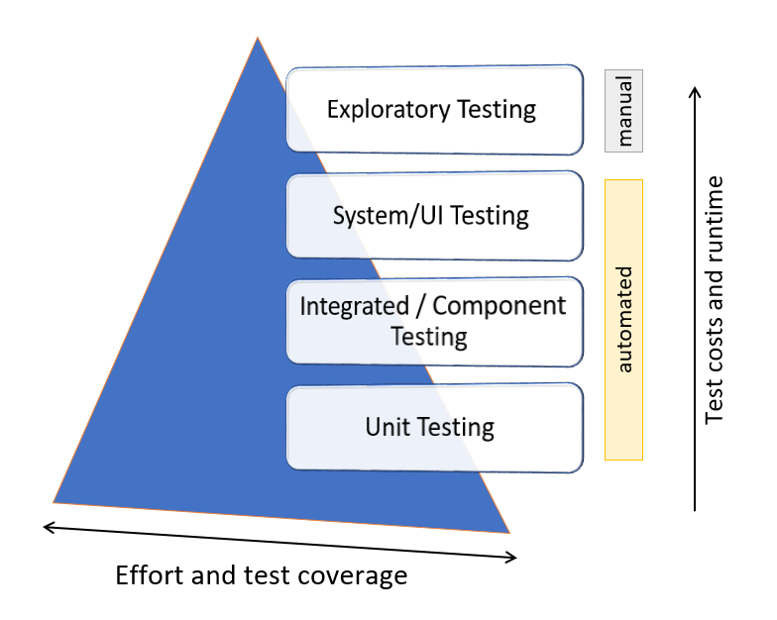
Test types
The Pareto-principle is used: 20% of the test cases covers 80% of the features – if properly designed!
Unit tests/Component tests
  Test automates that validate the behaviour of a single implementation unit (e.g. a method of a class) or a component (e.g. a function module, a program in ABAP)
  They are usually completely isolated from the dependencies to ensure speed and stability
  Test data: these tests should work without any existing test data in the system. The test cases should provide their own test data (using mock data, etc)
  Volume of coverage: high
  Cost: low, minimal test environment (usually built-in tools) required
Integration tests
  These verify how the modules communicate and behave together.
  Can evaluate the compliance of a system (e.g. Odata test)
  Test isolation is only partial to prevent data persistency, but allow interaction between dependent modules.
  Test data: No real data, expected database or system data should be mocked.
  Volume of coverage: medium, the most important module interactions should be chosen carefully
  Cost: medium, configuration and mocking in the test environment is more extensive

Slide 7
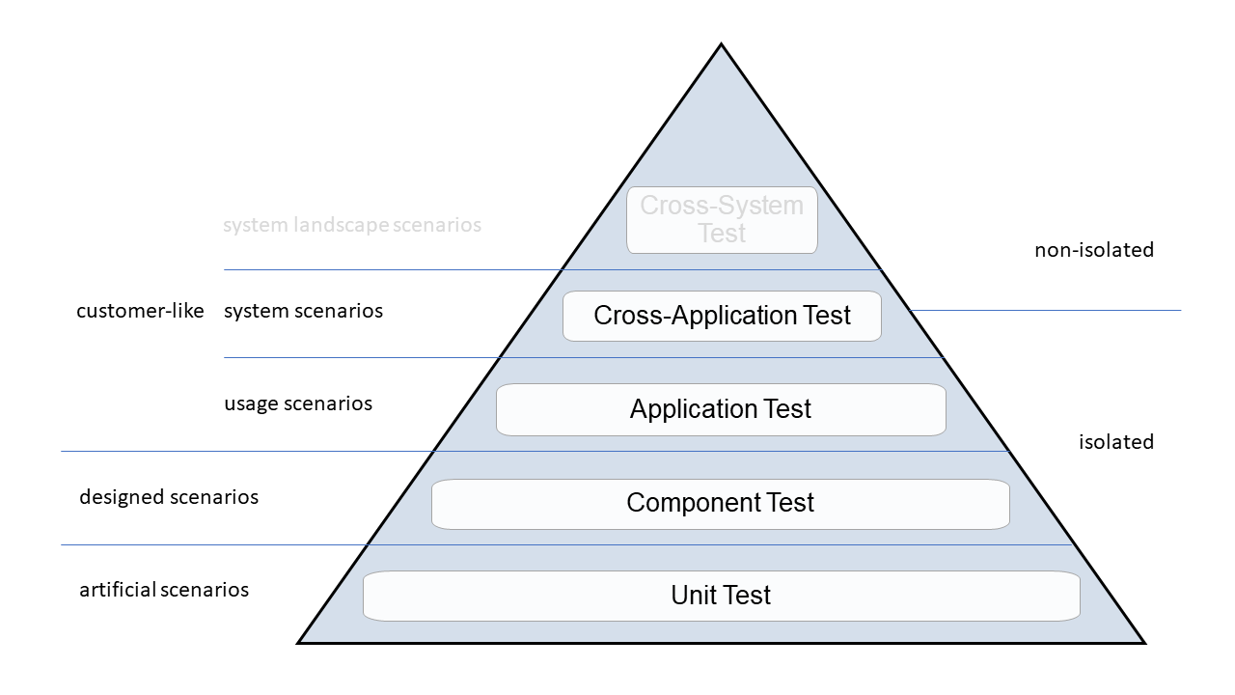
Test types
Smoke tests
  Examine whether the system build is stable or not.
  Their purpose is to verify if the main functionalities work properly
  Level of dependency isolation is low
  Test data: These tests might require generation of real test data.
  Volumen of coverage: Low
  Cost: medium, requires complex test environemnet setup
System tests (cross-application tests)
  Verify that a recent change in code doesn’t affect any existing features of the application, especially it did not break any functionality that was working correctly prior to their implementation.
  Simulates scenarios how an end user would interact with the application.
  Isolation level: no isolation
  Test data: this type of test requires existing data in the system (can be generated by dedicated tools), no mocks are used usually.
  Volume of coverage: the most important or most risky features are selected for such tests.
  Cost: high, requires complex test environemnet setup

Slide 8
Overview and Motivation
Integrated/system tests (1)
Advantages
    Tests run in real environment
Disadvantages
    Can be built only at end of development
    Complex setup of environment
    Long running tests
    High effort to analyze errors
    Fragile
    High maintenance
Integrated / System Test
B
A
ATDD
C
D
X
E
F

Slide 9

Overview and Motivation
Integrated/system tests (2)
Using only integrated/system tests at the end of development is like putting together an airplane without testing the parts…
…and then conducting the first test flight!
Integrated / System Test
B
A
ATDD
C
D
X
E
F

Slide 10

Overview and Motivation
Unit tests
Advantages
    Can be built during development
    Isolated from the environment
    Fast
    Error analysis easy
    Stable
    Low maintenance
Disadvantage
    Tests run in simulated environment
B
A
ATDD
D
Unit Test
C
X
E
F

Slide 11
Overview and Motivation
Importance of tests
“If the tests are good, then the product code is probably good enough.
If tests are bad or do not exist, then all hope is lost.”
Gerard Meszaros – @SAP 2012
Author of “xUnit Test Patterns”

Slide 12
Testable objects

Slide 13
Which objects can be tested by automates?
Classes/methods
  ABAP classes provide a dedicated test include to place the test code for the given class.
Function modules
  Function modules are located in includes and the include with suffix T99 is the dedicated include in which all test automats for all function modules of the function group have to be located.
  You can also use global test classes with one or more internal test classes to cover different scenarios of a larger function module. You can use test relations to bind the test classes to the tested function.
Programs
  If you have an existing report that you need to test, you can test any FORM and local class within the report, but you cannot simply test the code located in the START-OF-SELECTION area of the report.
  Therefore you have to refactor the report to work either with forms, local or global classes.

Slide 14
Which objects can be tested by automates?
CDS views
  Shall have a unit test if they:
    contain business logic (e.g. CASE/WHEN statements to derive new properties).
    are combined to a complex view stack that calculates properties.
    contain complicated JOIN or UNION logic.
  You should use test relations to bind the test classes to the tested CDS view.
  To test CDS views, make use of the CDS test double framework.
DCL (Data Control Objects)
  If access to CDS views is restricted by authorization checks, those are also subject to uit tests.
AMDPs and Table Functions
  Special enttites ambodying business logic in ABAP classes. Are also subject to unit testing.

Slide 15
Which objects can be tested by automates?
Odata services
  Classical OData services are developed with Gateway and result in two classes with suffix “_DPC_EXT” and “_MPC_EXT” that allow modifications within the service processing. It is highly recommended to add local unit tests to those classes.
  Additionally, modifying services shall have integration tests. These E2E tests should be in a dedicated global test class to enable you to trigger the fast and isolated unit tests on the “*_EXT” classes and the long running (sometimes not isolated) E2E tests individually by running the global test classes.
  OData services shall be developed using the Restful ABAP Programming model (RAP) shall have at least a smoke test (e.g. GET of an EntitySet) to validate the proper binding.
    CREATE, UPDATE, DELETE or FUNCTIONS may be subject to dedicated tests.

Slide 16
Which objects can be tested by automates?
Business Add-In (BAdI)
  The BAdIlogic itself can be unit tested inits own implementing class.
  The caller logic can be tested with unit tests, but the CALL BADI and GET BADI statements must be treated as dependencies -> isolate them.
AUTHORITY-CHECK
  There is a dedicated test helper cl_aunit_authority_check.
  In combination with a test user who has all the necessary authorizations the solution makes it possible to write positive and negative tests.
Restfull ABAP Programming (RAP) business objects
  Depending on the BO implemetation method (managed/unmanaged) the underlying classes can be unit tested individually.
  The behavior of the BO can be integration tested using EML statements.
    Recommendation: define combined test scenarios (e.g. Create -> Update -> Commit, Create -> Read, ...)

Slide 17
The ABAP Unit framework

Slide 18
Introduction to ABAP Unit
Product code
CLASS cl_money_machine DEFINITION
PUBLIC
FINAL
CREATE PUBLIC.
PUBLIC SECTION.
METHODS get_amount_in_coins
IMPORTING i_amount TYPE i
RETURNING VALUE(r_value) TYPE i.
PROTECTED SECTION.
PRIVATE SECTION.
ENDCLASS.
CLASS cl_money_machine IMPLEMENTATION.
METHOD get_amount_in_coins.
r_value = COND #( WHEN i_amount <= 0
THEN -1
ELSE i_amount MOD 5 ).
ENDMETHOD.
ENDCLASS.

Slide 19
Introduction to ABAP Unit
Add a test class
Product code
Test include
CLASS cl_money_machine DEFINITION
PUBLIC
FINAL
CREATE PUBLIC.
PUBLIC SECTION.
METHODS get_amount_in_coins
IMPORTING i_amount TYPE i
RETURNING VALUE(r_value) TYPE i.
PROTECTED SECTION.
PRIVATE SECTION.
ENDCLASS.
CLASS cl_money_machine IMPLEMENTATION.
METHOD get_amount_in_coins.
r_value = COND #( WHEN i_amount <= 0
THEN -1
ELSE i_amount MOD 5 ).
ENDMETHOD.
ENDCLASS.
CLASS ltc_get_amount_in_coins DEFINITION FOR TESTING
RISK LEVEL HARMLESS
DURATION SHORT.
ENDCLASS.
CLASS ltc_get_amount_in_coins IMPLEMENTATION.
ENDCLASS.

Slide 20
Introduction to ABAP Unit
Add a test method
Product code
Test include
CLASS cl_money_machine DEFINITION
PUBLIC
FINAL
CREATE PUBLIC.
PUBLIC SECTION.
METHODS get_amount_in_coins
IMPORTING i_amount TYPE i
RETURNING VALUE(r_value) TYPE i.
PROTECTED SECTION.
PRIVATE SECTION.
ENDCLASS.
CLASS cl_money_machine IMPLEMENTATION.
METHOD get_amount_in_coins.
r_value = COND #( WHEN i_amount <= 0
THEN -1
ELSE i_amount MOD 5 ).
ENDMETHOD.
ENDCLASS.
CLASS ltc_get_amount_in_coins DEFINITION FOR TESTING
RISK LEVEL HARMLESS
DURATION SHORT.
PRIVATE SECTION.
METHODS amount_1_coin_1 FOR TESTING.
ENDCLASS.
CLASS ltc_get_amount_in_coins IMPLEMENTATION.
METHOD amount_1_coin_1.
ENDMETHOD.
ENDCLASS.

Slide 21
Introduction to ABAP Unit
Test method story
Product code
Test include
CLASS cl_money_machine DEFINITION
PUBLIC
FINAL
CREATE PUBLIC.
PUBLIC SECTION.
METHODS get_amount_in_coins
IMPORTING i_amount TYPE i
RETURNING VALUE(r_value) TYPE i.
PROTECTED SECTION.
PRIVATE SECTION.
ENDCLASS.
CLASS cl_money_machine IMPLEMENTATION.
METHOD get_amount_in_coins.
r_value = COND #( WHEN i_amount <= 0
THEN -1
ELSE i_amount MOD 5 ).
ENDMETHOD.
ENDCLASS.
CLASS ltc_get_amount_in_coins DEFINITION FOR TESTING
RISK LEVEL HARMLESS
DURATION SHORT.
PRIVATE SECTION.
"! Amount of 1 EUR results in 1 EUR coin
METHODS amount_1_coin_1 FOR TESTING.
ENDCLASS.
CLASS ltc_get_amount_in_coins IMPLEMENTATION.
METHOD amount_1_coin_1.
"given
"when
"then
ENDMETHOD.
ENDCLASS.

Slide 22
Introduction to ABAP Unit
Test method content
Product code
Test include
CLASS cl_money_machine DEFINITION
PUBLIC
FINAL
CREATE PUBLIC.
PUBLIC SECTION.
METHODS get_amount_in_coins
IMPORTING i_amount TYPE i
RETURNING VALUE(r_value) TYPE i.
PROTECTED SECTION.
PRIVATE SECTION.
ENDCLASS.
CLASS cl_money_machine IMPLEMENTATION.
METHOD get_amount_in_coins.
r_value = COND #( WHEN i_amount <= 0
THEN -1
ELSE i_amount MOD 5 ).
ENDMETHOD.
ENDCLASS.
CLASS ltc_get_amount_in_coins DEFINITION FOR TESTING
RISK LEVEL HARMLESS
DURATION SHORT.
PRIVATE SECTION.
"! Amount of 1 EUR results in 1 EUR coin
METHODS amount_1_coin_1 FOR TESTING.
ENDCLASS.
CLASS ltc_get_amount_in_coins IMPLEMENTATION.
METHOD amount_1_coin_1.
"given
DATA(cut) = NEW cl_money_machine( ).
"when
DATA(coin_amount) = cut->get_amount_in_coins( 1 ).
"then
cl_abap_unit_assert=>assert_equals( act = coin_amount
exp = 1 ).
ENDMETHOD.
ENDCLASS.

Slide 23
Introduction to ABAP Unit
Second test method
Test include
Test include
CLASS ltc_get_amount_in_coins DEFINITION FOR TESTING
RISK LEVEL HARMLESS
DURATION SHORT.
PRIVATE SECTION.
"! Amount of 1 EUR results in 1 EUR coin
METHODS amount_1_coin_1 FOR TESTING.
"! Amount of 2 EUR results in 2 EUR coin
METHODS amount_2_coin_2 FOR TESTING.
ENDCLASS.
CLASS ltc_get_amount_in_coins IMPLEMENTATION.
METHOD amount_1_coin_1.
"given
DATA(cut) = NEW cl_money_machine( ).
"when
DATA(coin_amount) = cut->get_amount_in_coins( 1 ).
"then
cl_abap_unit_assert=>assert_equals( act = coin_amount exp = 1 ).
ENDMETHOD.
METHOD amount_2_coin_2.
"given
DATA(cut) = NEW cl_money_machine( ).
"when
DATA(coin_amount) = cut->get_amount_in_coins( 2 ).
"then
cl_abap_unit_assert=>assert_equals( act = coin_amount exp = 2 ).
ENDMETHOD.
ENDCLASS.

Slide 24

Introduction to ABAP Unit
Unit test framework – Special methods
  CLASS_SETUP
  static method, called once before the first SETUP of the test class
  SETUP
  instance method, called before each test method
  TEARDOWN
  instance method, called after each test method
  CLASS_TEARDOWN
  static method, called once after the last TEARDOWN of the test class
Common properties
  optional – only define them if you need them
  private
  have no parameters

Slide 25
Introduction to ABAP Unit
Refactor test
Test include
Test include
CLASS ltc_get_amount_in_coins DEFINITION FOR TESTING
RISK LEVEL HARMLESS
DURATION SHORT.
PRIVATE SECTION.
"! Amount of 1 EUR results in 1 EUR coin
METHODS amount_1_coin_1 FOR TESTING.
"! Amount of 2 EUR results in 2 EUR coin
METHODS amount_2_coin_2 FOR TESTING.
ENDCLASS.
CLASS ltc_get_amount_in_coins IMPLEMENTATION.
METHOD amount_1_coin_1.
"given
DATA(cut) = NEW cl_money_machine( ).
"when
DATA(coin_amount) = cut->get_amount_in_coins( 1 ).
"then
cl_abap_unit_assert=>assert_equals( act = coin_amount
exp = 1 ).
ENDMETHOD.
METHOD amount_2_coin_2.
"given
DATA(cut) = NEW cl_money_machine( ).
"when
DATA(coin_amount) = cut->get_amount_in_coins( 2 ).
"then
cl_abap_unit_assert=>assert_equals( act = coin_amount
exp = 2 ).
ENDMETHOD.
ENDCLASS.

Slide 26
Introduction to ABAP Unit
Refactor test methods
Test include
Test include
CLASS ltc_get_amount_in_coins DEFINITION FOR TESTING
RISK LEVEL HARMLESS
DURATION SHORT.
PRIVATE SECTION.
DATA m_cut TYPE REF TO cl_money_machine.
METHODS setup.
"! Amount of 1 EUR results in 1 EUR coin
METHODS amount_1_coin_1 FOR TESTING.
"! Amount of 2 EUR results in 2 EUR coin
METHODS amount_2_coin_2 FOR TESTING.
ENDCLASS.
CLASS ltc_get_amount_in_coins IMPLEMENTATION.
METHOD setup.
"given
m_cut = NEW cl_money_machine( ).
ENDMETHOD.
METHOD amount_1_coin_1.
"when
DATA(coin_amount) = m_cut->get_amount_in_coins( 1 ).
"then
cl_abap_unit_assert=>assert_equals( act = coin_amount
exp = 1 ).
ENDMETHOD.
METHOD amount_2_coin_2.
"when
DATA(coin_amount) = m_cut->get_amount_in_coins( 2 ).
"then
cl_abap_unit_assert=>assert_equals( act = coin_amount
exp = 2 ).
ENDMETHOD.
ENDCLASS.

Slide 27
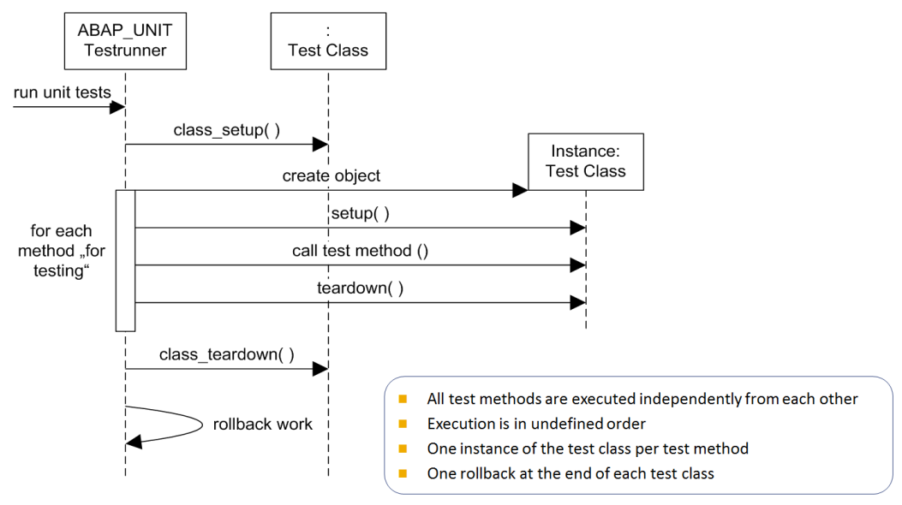
Introduction to ABAP Unit
ABAP unit run time
  All test methods are executed independently of each other
  Execution is in undefined order
  One instance of the test class per test method
  One rollback at the end of each test class

Slide 28

Introduction to ABAP Unit
The “then” part of the test story
Assert helper methods in class cl_abap_unit_assert
  assert_equals( .. )
  assert_bound( .. ) / assert_not_bound( .. )
  assert_initial( .. ) / assert_not_initial( .. )
  assert_true( .. ) / assert_false( .. )
  assert_subrc( .. )
  fail( .. )
  abort( .. )
They all pass messages to the ABAP unit runner

Slide 29
Using Decoupling Techniques for Test Isolation
Test code without dependencies
Direct input
Test Case
Code Under Test
Direct output

Slide 30

Using Decoupling Techniques for Test Isolation
Test code without dependencies – Possible error locations
Direct input
Test Case
Code Under Test
Direct output

Slide 31
Using Decoupling Techniques for Test Isolation
Test code without dependencies – Example
ltc_get_amount_in_coins
cl_money_machine
i_amount = 1
amount_1_coin_1
get_amount_in_coins
r_value = 1

Slide 32
Using Decoupling Techniques for Test Isolation
Test code with dependencies
Direct input
Indirect output
Test Case
Code Under Test
Depended-On Component
Direct output
Indirect input

Slide 33
Using Decoupling Techniques for Test Isolation
Test code with dependencies – Possible error locations
Direct input
Indirect output
Test Case
Code Under Test
Depended-On Component
Direct output
Indirect input

Slide 34
Using Decoupling Techniques for Test Isolation
Test code with dependencies – Example
ltc_get_amount_in_coins
cl_money_machine
cl_cash_provider
i_amount = 1
i_currency = EUR
amount_1_coin_1
get_amount_in_coins
get_coins
r_value = 1
r_coins = 1, 2

Slide 35
Using Decoupling Techniques for Test Isolation
Test doubles
controls
Direct input
Indirect output
Test Case
Code Under Test
Test Double
Direct output
Indirect input

Slide 36









Using Decoupling Techniques for Test Isolation
Reasons to replace a depended-on component with a test double
Slow
Expensive
Unstable values
Non-existent
Unwanted output
Broken
In development
Not allowed
Needs user input
Provoke error behavior

Slide 37
Test Double Frameworks
ABAP test double framework
  Standardized solution for creating test doubles and configuring their behavior
  Supports the automatic creation of test doubles for global interfaces
  Method call behavior can be configured using the framework API
  It is possible to define the values of returning, exporting, and changing parameters and raise exceptions or events
  Additionally, the framework provides functionality to verify interactions on the test double object, e.g. the number of times a method was called with specific input parameters
…
" step 1: create the test double of interface type
test_double ?= cl_abap_testdouble=>create(
'if_some_global_interface' ).
" step 2: configure the test double behavior
cl_abap_testdouble=>configure_call( test_double
)->returning( abap_true
)->ignoring_all_parameters(
)->and_expect(
)->is_called_once( ).
" step 3: configure the test double method
test_double->method_to_double(
EXPORTING i_parameter_1 = 0
i_parameter_2 = abap_true ).
…

Slide 38
Test Double Frameworks
Open SQL test double framework
  Is an addition to the existing ABAP unit test framework
  Enables testing of Open SQL statements present in your ABAP code through the normal ABAP unit test classes
  It can be used for testing Open SQL logic written inside any of the development objects, e.g. classes, function modules, reports
DATA m_table_1 TYPE STANDARD TABLE OF table_1.
…
METHOD class_setup.
g_environment = cl_osql_test_environment=>create(
i_dependency_list_entity = VALUE #(
( 'table_1' ) ).
ENDMETHOD.
METHOD class_teardown.
g_environment->destroy( ).
ENDMETHOD.
METHOD setup.
g_environment->clear_doubles( ).
ENDMETHOD.
METHOD some_test_method.
"given
m_table_1 = VALUE #( … ).
g_environment->insert_test_data( m_table_1 ).
"when
DATA(result) = m_cut->method_with_db_statements( ).
"then
cl_abap_unit_assert=>assert_equals( act = result
exp = 1 ).
ENDMETHOD

Slide 39
Test Double Frameworks
Core Data Service (CDS) test double framework
  Is able to double the depended-on components of CDS views
  Depended-on components can be for example database tables, database views, or other CDS views
  Can double all direct depended-on components, which is a unit test of the CDS view
  Can double depended-on components on any hierarchy level, which then is still isolated, but tests some levels of the hierarchy
DATA m_table_1 TYPE STANDARD TABLE OF table_1.
…
METHOD class_setup.
g_environment = cl_cds_test_environment=>create(
i_for_entity = 'CDS_under_test' ).
ENDMETHOD.
METHOD class_teardown.
g_environment->destroy( ).
ENDMETHOD.
METHOD setup.
g_environment->clear_doubles( ).
ENDMETHOD.
METHOD some_test_method.
"given
m_table_1 = VALUE #( ... ).
g_environment->insert_test_data( m_table_1 ).
"when
SELECT field FROM CDS_under_test
INTO @DATA(act_tab).
"then
cl_abap_unit_assert=>assert_equals(
act = act_tab
exp = m_exp_tab ).
ENDMETHOD

Slide 40
Test Double Frameworks
ABAP test seams
  Have no influence on the product code
  Exchange code snippets of the product code with test double code during test run time
  Test seams are limited to the same compilation unit!
Product code
Test code
…
AUTHORITY-CHECK OBJECT 'S_ANY'
ID 'SABC' FIELD 'TABL'.
TEST-SEAM manipulate_authority.
END-TEST-SEAM.
IF sy-subrc <> 0. ... ENDIF.
…
TEST-SEAM remove_unwanted_statement.
CALL FUNCTION 'SOMETHING_WE_DONT_WANT_IN_THE_TEST'.
END-TEST-SEAM.
…
…
TEST-INJECTION manipulate_authority.
sy-subrc = 0.
END-TEST-INJECTION.
TEST-INJECTION remove_unwanted_statement.
"empty injection
END-TEST-INJECTION.
…

Slide 41
Test Isolation – What do we want to achieve?
Make code testable
Legacy code (code without tests) usually cannot be tested without changes to the product code.
In order to write tests, the following steps have to be worked through:
Find the seams – where does the program flow leaves the code under test?
Provide testability – decouple the found seams
Provide an injection mechanism – prepare the usage of test doubles
Implement the test double – write a test double
Write the test – put all together and write the test

Slide 42
Test Isolation – Preparation
Find the seams
Find the seams
Provide testability
Provide an injection mechanism
Implement the test double
Write the test

Slide 43

Test Isolation – Preparation
Find the seams
Seams are code locations, where the code interacts with the entities outside of the code unit
Seams depend on the use case
  Unit tests want no dependencies
  Integration/system tests might only isolate a few dependencies
Examples of seams
  Create an object or call a method
  Interact with a database
  Call a function
  Call a report
  Get or call a BAdI
  Write or read global variables
  Get the ‘current time’
  …

Slide 44
Test Isolation – Preparation
Provide testability
Find the seams
Provide testability
Provide an injection mechanism
Implement the test double
Write the test

Slide 45
Test Isolation – Preparation
Provide testability – Create an object with an interface
Problem
Solution – Lightweight depended-on component
METHOD get_amount_in_coins.
DATA cash_provider TYPE REF TO if_cash_provider.
cash_provider = NEW cl_cash_provider( ).
DATA(notes) = cash_provider->get_notes( 'EUR' ).
SORT notes BY amount ASCENDING.
r_value = COND #( WHEN i_amount <= 0
THEN -1
ELSE i_amount MOD notes[ 1 ]-amount ).
ENDMETHOD.
CLASS cl_money_machine DEFINITION …
PUBLIC SECTION.
METHODS constructor.
…
PRIVATE SECTION.
DATA m_cash_provider TYPE REF TO if_cash_provider.
ENDCLASS.
CLASS cl_money_machine IMPLEMENTATION.
…
METHOD constructor.
m_cash_provider = NEW cl_cash_provider( ).
ENDMETHOD.
METHOD get_amount_in_coins.
DATA(notes) = m_cash_provider->get_notes( 'EUR' ).
SORT notes BY amount ASCENDING.
r_value = COND #(
WHEN i_amount <= 0
THEN -1
ELSE i_amount MOD notes[ 1 ]-amount ).
ENDMETHOD.
…
ENDCLASS.

Slide 46
Test Isolation – Preparation
Provide testability – Create an object with an interface
Solution – Lightweight depended-on component
Solution – Heavyweight depended-on component
CLASS cl_money_machine DEFINITION …
PUBLIC SECTION.
METHODS constructor.
…
PRIVATE SECTION.
DATA m_cash_provider TYPE REF TO if_cash_provider.
ENDCLASS.
CLASS cl_money_machine IMPLEMENTATION.
…
METHOD constructor.
m_cash_provider = NEW cl_cash_provider( ).
ENDMETHOD.
METHOD get_amount_in_coins.
DATA(notes) = m_cash_provider->get_notes( 'EUR' ).
SORT notes BY amount ASCENDING.
r_value = COND #(
WHEN i_amount <= 0
THEN -1
ELSE i_amount MOD notes[ 1 ]-amount ).
ENDMETHOD.
…
ENDCLASS.
CLASS cl_money_machine DEFINITION
…
PRIVATE SECTION.
DATA m_cash_provider TYPE REF TO if_cash_provider.
METHODS cash_provider RETURNING VALUE(r_provider)
TYPE REF TO if_cash_provider.
ENDCLASS.
CLASS cl_ money_machine IMPLEMENTATION.
…
METHOD cash_provider. "lazy instantiation
IF m_cash_provider IS NOT BOUND.
m_cash_provider = NEW cl_cash_provider( ).
ENDIF.
r_provider = m_cash_provider.
ENDMETHOD.
METHOD get_amount_in_coins.
DATA(notes) = cash_provider( )->get_notes( 'EUR' ).
SORT notes BY amount ASCENDING.
r_value = COND #(
WHEN i_amount <= 0
THEN -1
ELSE i_amount MOD notes[ 1 ]-amount ).
ENDMETHOD.
…
ENDCLASS.

Slide 47
Test Isolation – Preparation
Provide testability – Depended-on component without an interface
Problem
Solution – Local implementation
METHOD get_amount_in_coins.
DATA cash_provider TYPE REF TO cl_cash_provider.
cash_provider = NEW #( ).
DATA(notes) = cash_provider->get_notes( 'EUR' ).
SORT notes BY amount ASCENDING.
r_value = COND #(
WHEN i_amount <= 0
THEN -1
ELSE i_amount MOD notes[ 1 ]-amount ).
ENDMETHOD.
CLASS lcl_cash_provider DEFINITION.
PUBLIC SECTION.
INTERFACES lif_cash_provider.
METHODS constructor.
PRIVATE SECTION.
DATA m_cash_provider TYPE REF TO cl_cash_provider.
ENDINTERFACE.
CLASS lcl_cash_provider IMPLEMENTATION.
METHOD constructor.
m_cash_provider = NEW cl_cash_provider( ).
ENDMETHOD.
METHOD lif_cash_provider~get_notes.
r_notes = m_cash_provider->get_notes( i_currency ).
ENDMETHOD.
ENDCLASS.
Solution – Local or global interface
INTERFACE lif_cash_provider.
METHODS get_notes
IMPORTING
i_currency TYPE string
RETURNING
VALUE(r_notes) TYPE cl_money_machine=>tt_change.
ENDINTERFACE.
…and now apply one of the previous solutions…

Slide 48

Test Isolation – Preparation
Provide testability
“Create interfaces for all your classes. Always.”
Interfaces are the heart of testability.
The users of your code will be grateful.

Slide 49
Test Isolation – Injection
Provide an injection mechanism
Find the seams
Provide testability
Provide an injection mechanism
Implement the test double
Write the test

Slide 50

Test Isolation – Injection
Provide an injection mechanism
Depended-on component (DOC) can be injected in…
  Constructor method during object creation
  (constructor injection)
  Setter method before test is started
  (setter injection)
  Parameter in method under test at test start
  (parameter injection)
  Object attribute via friendship relation before test is started
  (backdoor injection)
  Product code performs dependency lookup using object factory

Slide 51
Test Isolation – Injection
Constructor injection / setter injection
Constructor injection – Product code
Setter injection – Product code
CLASS … DEFINITION … .
PUBLIC SECTION.
METHODS constructor IMPORTING i_cash_provider
TYPE REF TO if_cash_provider OPTIONAL.
PRIVATE SECTION.
DATA m_cash_provider TYPE REF TO if_cash_provider.
…
ENDCLASS.
CLASS … IMPLEMENTATION.
METHOD constructor.
m_cash_provider = COND #(
WHEN i_cash_provider IS BOUND
THEN i_cash_provider
ELSE NEW cl_cash_provider( ) ).
ENDMETHOD.
…
ENDCLASS.
CLASS … DEFINITION … .
PUBLIC SECTION.
METHODS set_cash_provider IMPORTING i_cash_provider
TYPE REF TO if_cash_provider.
PRIVATE SECTION.
DATA m_cash_provider TYPE REF TO if_cash_provider.
…
ENDCLASS.
CLASS … IMPLEMENTATION.
METHOD set_cash_provider.
m_cash_provider = i_cash_provider.
ENDMETHOD.
…
ENDCLASS.

Slide 52
Test Isolation – Injection
Parameter injection / backdoor injection
Parameter injection – Product code
Backdoor injection – Product code
CLASS … DEFINITION … .
PUBLIC SECTION.
METHODS get_amount_in_coins
IMPORTING
i_amount TYPE i
i_cash_provider TYPE REF TO if_cash_provider
OPTIONAL
RETURNING VALUE(r_value) TYPE i.
PRIVATE SECTION.
DATA m_cash_provider TYPE REF TO if_cash_provider.
…
ENDCLASS.
CLASS … IMPLEMENTATION.
METHOD get_amount_in_coins.
DATA(cash_provider) = CAST if_cash_provider(
COND #( WHEN i_cash_provider IS BOUND
THEN i_cash_provider
ELSE NEW cl_cash_provider( ) ) ).
…
ENDMETHOD.
…
ENDCLASS.
CLASS … DEFINITION … .
PRIVATE SECTION.
DATA m_cash_provider TYPE REF TO if_cash_provider.
…
ENDCLASS.
Backdoor Injection – Test Code
CLASS ltc_get_amount_in_coins DEFINITION DEFERRED.
CLASS cl_money_machine DEFINITION
LOCAL FRIENDS ltc_get_amount_in_coins.
CLASS ltc_get_amount_in_coins DEFINITION FOR TESTING … .
…
ENDCLASS.
CLASS ltc_get_amount_in_coins IMPLEMENTATION.
METHOD setup.
"given
m_cut = NEW #( ).
m_cut->m_cash_provider = NEW ltd_cash_provider( ).
ENDMETHOD.
ENDCLASS.

Slide 53
Test Isolation – Injection
Implement the test double
Find the seams
Provide testability
Provide an injection mechanism
Implement the test double
Write the test

Slide 54
Test Isolation – Injection
Implement the test double – Alternatives
Implement the interface of the depended-on component
  Interface provided, you are all set
  No interface provided
    Convince your colleague to provide an interface
    Implement your own interface as already seen
  Only implement the interface methods you need for the test using the keyword PARTIALLY IMPLEMENTED
Inherit from the depended-on component
  Redefine the methods where you need to have a test double for
  Drawback
    Not always possible due to FINAL definition of the class
    The risk to execute unwanted code in tests is higher e.g. when methods are added later in the code under test and are forgotten to be REDEFINEd in the subclass

Slide 55
Test Isolation – Injection
Write the test
Find the seams
Provide testability
Provide an injection mechanism
Implement the test double
Write the test

Slide 56

Test Isolation – Injection
Write test for existing code
  Adapt the code under test
    Find the seams
    Provide testability (high effort)
    Provide injection methods
  Create the test doubles
    Depended-on component behind an interface
    Implement the interface
  Create the test method
    Given: Inject test double in the code under test
    When: Call the code under test
    Then: Assert the test result

Slide 57
Test Isolation – Injection
Write test for existing code / write new code testable
  Adapt the code under test
    Find the seams
    Provide testability (high effort)
    Provide injection methods
  Create the test doubles
    Depended-on component behind an interface
    Implement the interface
  Create the test method
    Given: Inject test double in the code under test
    When: Call the code under test
    Then: Assert the test result
  Create the code under test
    Code is testable
    Injection methods have been provided
  Create the test doubles
    Depended-on component behind an interface
    Implement the interface
  Create the test method
    Given: Inject test double in the code under test
    When: Call the code under test
    Then: Assert the test result

Slide 58
Introduction to Dependency Lookup
Dependency lookup
The goal
  Classes of more abstract levels shall not depend on classes on more detailed levels
  Classes shall only depend on abstractions, e.g. interfaces
The solution
  Move the creation of objects to an object factory class
The testability advantage
  Offers a single point of injection for test doubles in unit tests and integration/system tests
Interface
create
Class
create
type
type
Interface
Interface
Class
Class
Interface
Class
get object
type
type
Factory
Interface
Interface
Class
Class
create
create

Slide 59
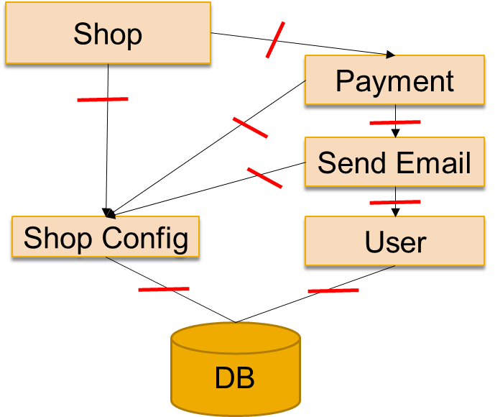
Multilevel Tests
Multilevel test isolation in large scopes
Component Test
Add a facade class to
encapsulate other components if they do not offer own object factories
inject test doubles
Component
interface
factory
Payment Function Group
DOC
Evolve step by step: Insert indirections as needed

Slide 60
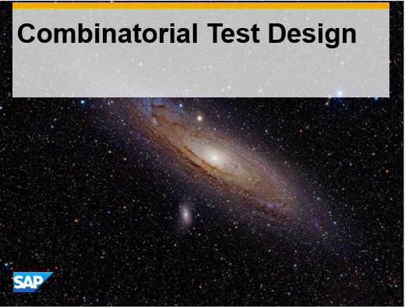
Unit Test Design, Tips, and Benefits
What cases to cover?
Consider for your test cases…
  Positive cases – correct values
  Negative cases – incorrect values
  Boundary values and their proximity
  Combinations of input values
For large numbers of independent but interacting variables, consider Combinatorial Test Design

Slide 61
Unit Test Design, Tips, and Benefits
Tips and tricks (1)
  Do not use test, verify etc. in test names
  Test class name shall express the “given” or the “when” semantic
  Test method name shall represent the other parts of the test story
  Always name the code under test CUT
  Group tests in a test class by same setup or same code under test, e.g. method
  Test methods tell a story
    Short and crisp in less than one screen
    In sections of Given – When – Then

Slide 62
Unit Test Design, Tips, and Benefits
Tips and tricks (2)
  Test only the public interface, not private methods
  One test method tests one test aspect
  F.I.R.S.T. paradigm
    Fast – tests run quickly
    Independent – clearly isolated
    Repeatable – constant behavior
    Self-validating – pass or fail
    Timely – write tests with the product code
  Refactor tests at least as good as product code Consider design principles
    KISS – keep it simple, stupid
    DRY – don’t repeat yourself

Slide 63
Introduction to Test-Driven Development
Process of test-driven development (TDD)
Code
Refactor
Write no product code except to pass a failing (red) test or a syntax error
Write only enough of a test to demonstrate a failure (next small step)
Write only enough product code to pass the test
After all tests pass (are green) again, clean up the test by refactoring!
Product code correct
All tests pass
Tests
Test is complete
Test not complete;
repeat
Write product code
Small
Requirements
Test fails
Write test code

Slide 64
Other tips for effective Test Automation
Use Code Coverage to measure the completeness of your test suite
Use Advanced techniques during Test development
  Test data classes
  Gherkin style code separation
    Given – When - Then
  Dependency isolation with factory doubles for big applications
Use Mutation testing to check the effectiveness of your tests (wiki)

Slide 65
Appendix

Slide 66
Useful materials
ABAP keyword documentation on SAP.HELP.COM
ABAPDOCU transaction in SAPGUI
ABAP Testdouble Framework – An introduction

Slide 67

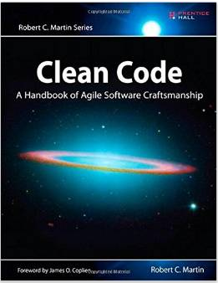

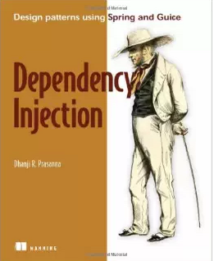
Links to articles and videos
    Martin Fowler: Inversion of Control containers and dependency lookup
      http://martinfowler.com/articles/injection.html
    Misko Hevery: Google Clean Code video series
      http://googletesting.blogspot.in/2008/08/by-miko-hevery-so-you-decided-to.html
      https://www.google.de/?gws_rd=ssl#q=writing+testable+code
    Michael Feathers: "On the deep synergy between testability and good design"
  More sources
    Misko Hevery (Google) Bob Martin Michael Feathers
… more

